Slide 1


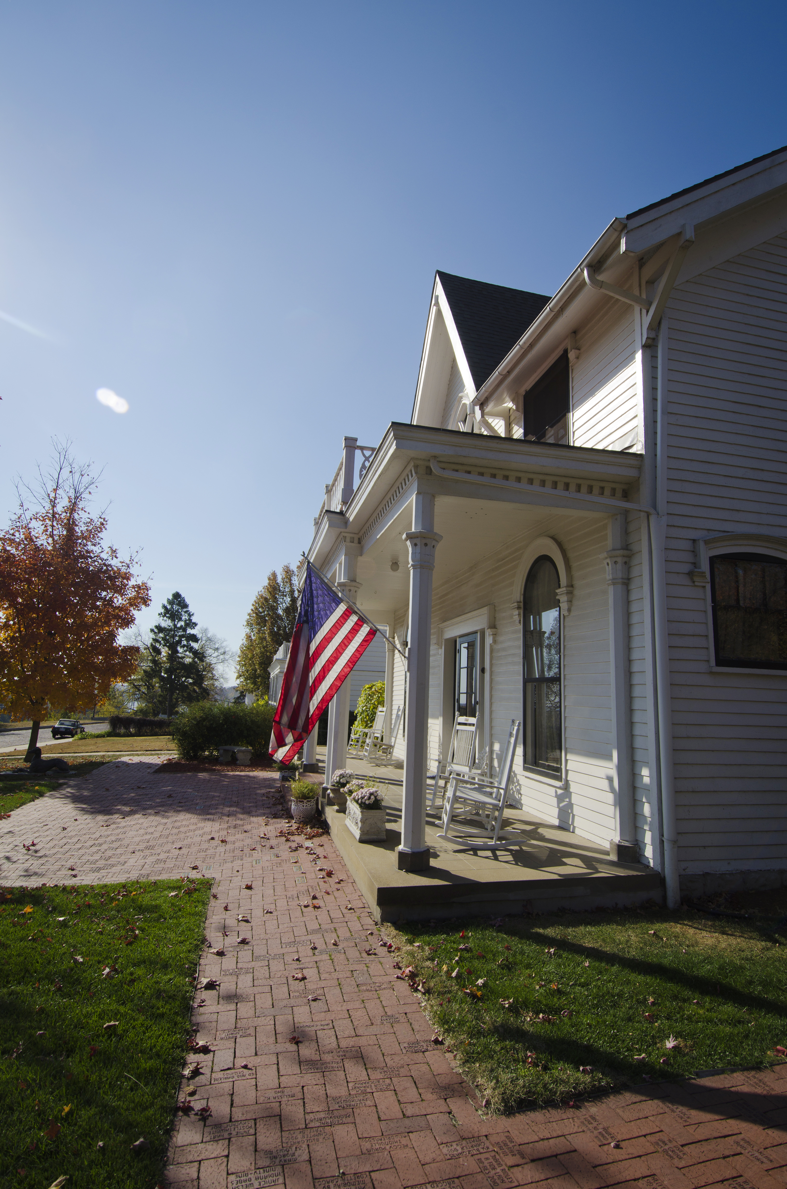


KANSAS DEPARTMENT OF COMMERCE
State Incentive Overview

Slide 2

MANAGER BUSINESS RECRUITMENT
ALICIA JANESKO HUTCHINGS

Slide 3
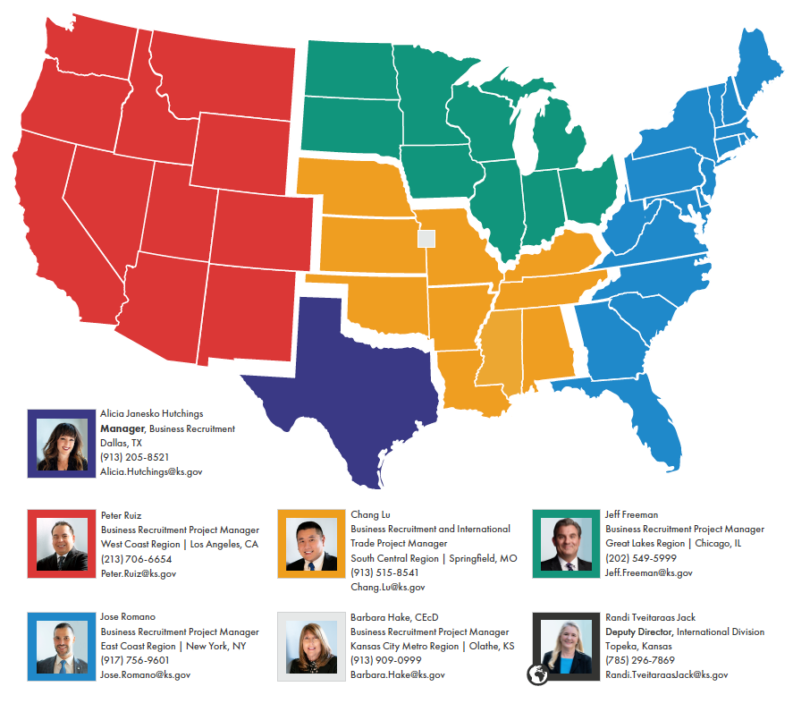
Business Recruitment Team

Slide 4
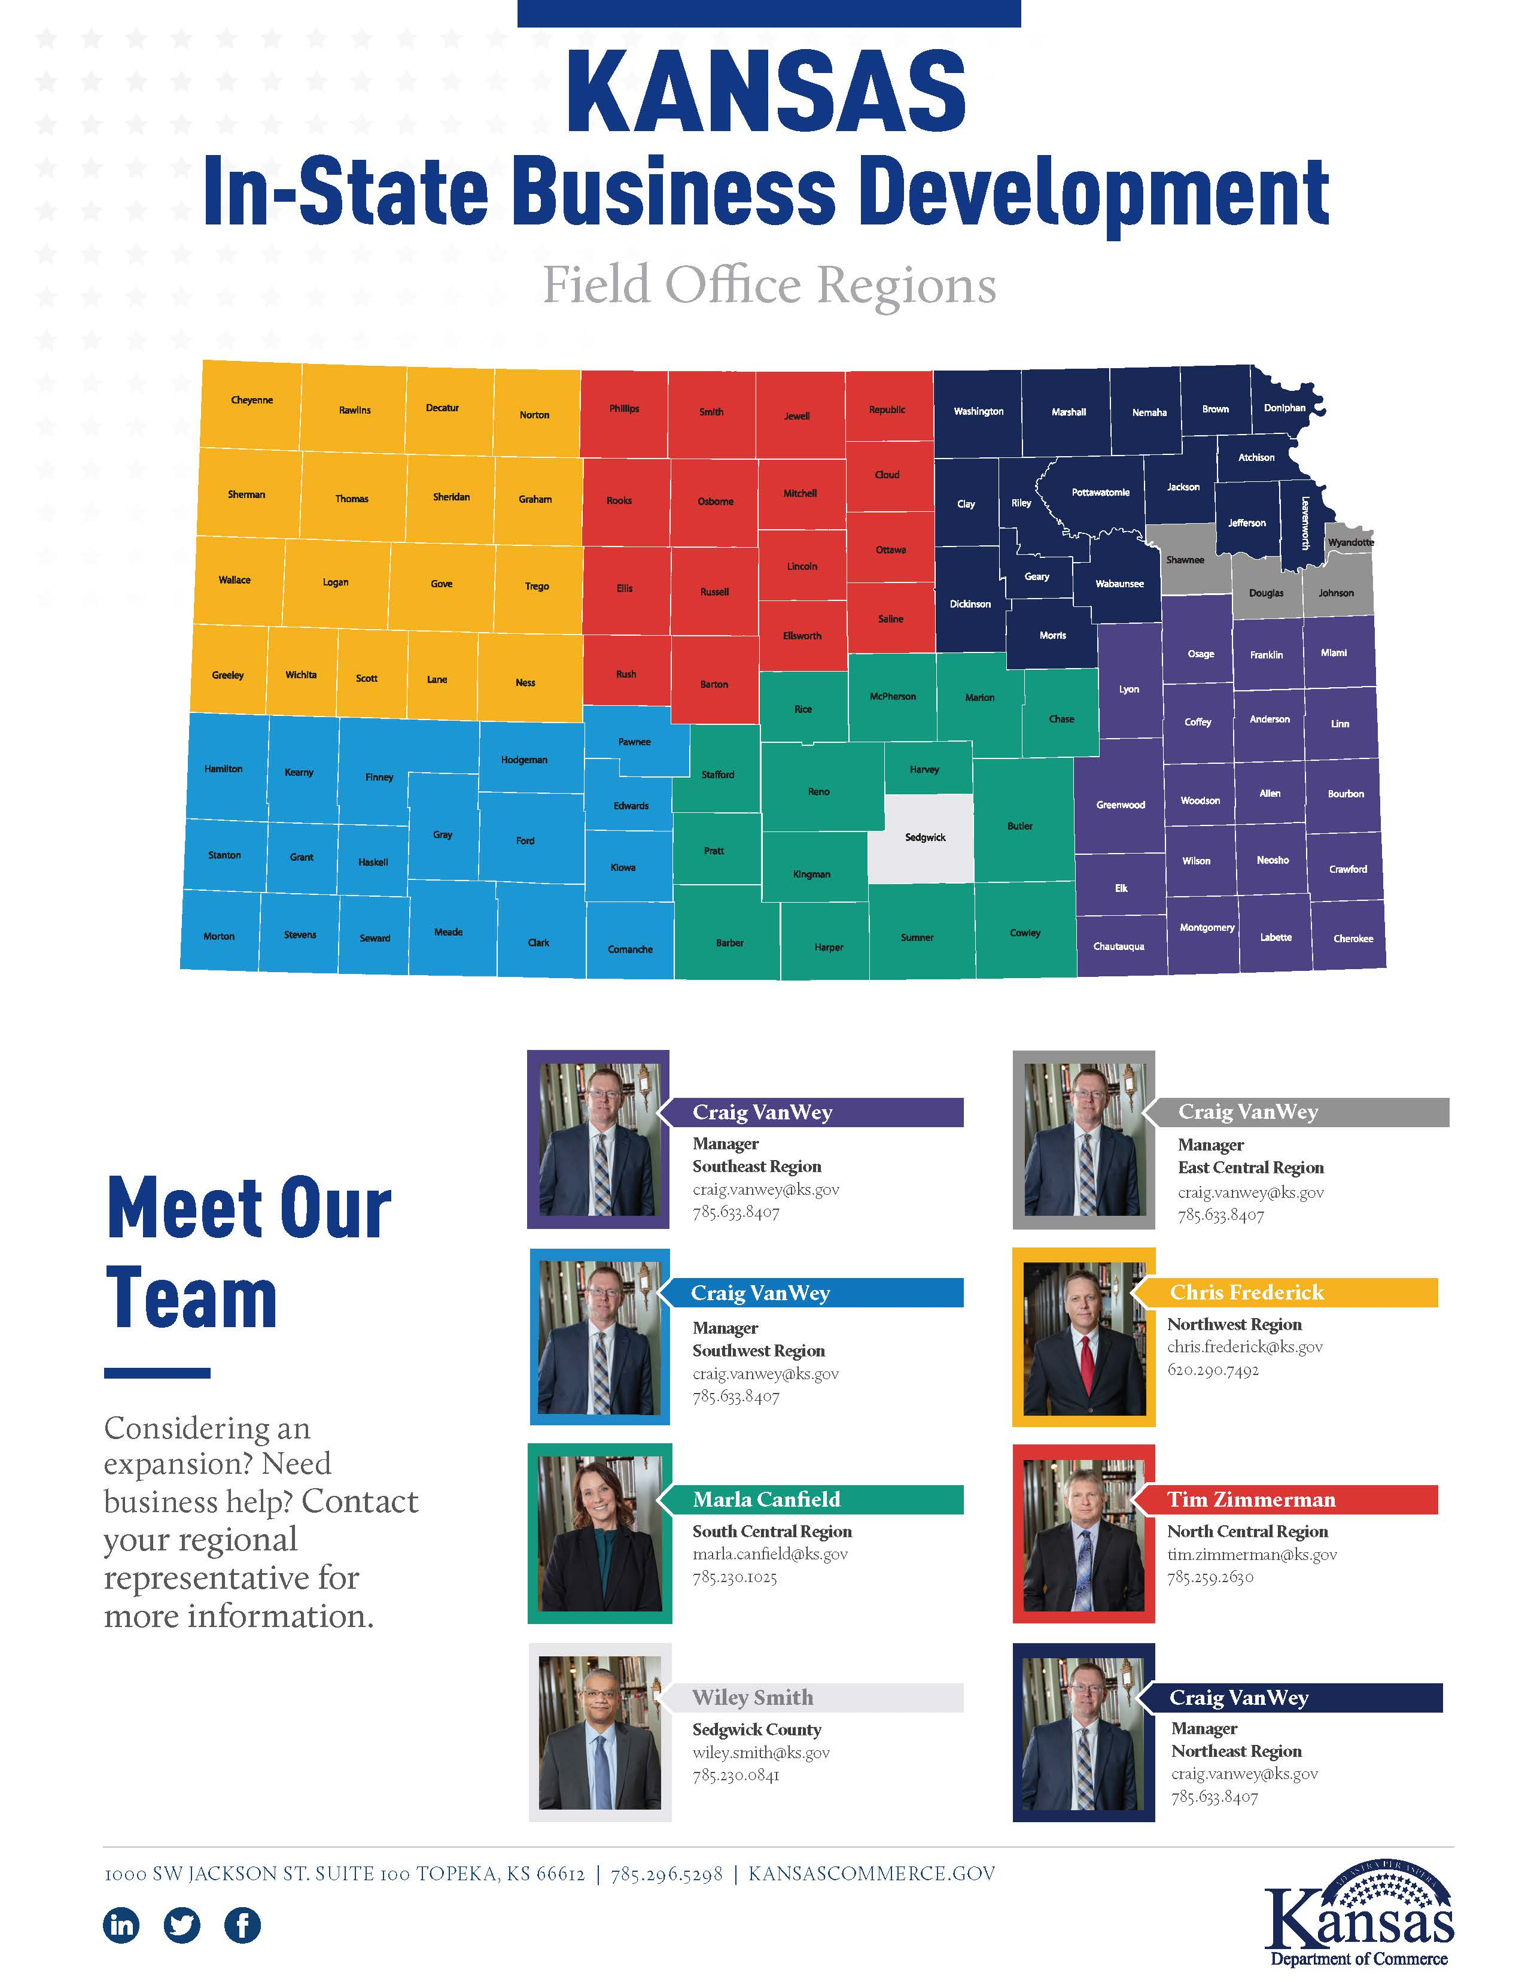
In-State Business Development Team

Slide 5
PROMOTING EMPLOYMENT ACROSS KANSAS (PEAK)
WITHHOLDING TAX PROGRAM
95% of withholding tax retained or refunded to a company
Benefit Period
  5 – 7 years withholding tax benefit period
    Requires 10 new jobs in metro areas / 5 in non-metro areas
  7 - 10 years withholding tax benefit period
    Requires 100 net new jobs in two years
Key Requirements
  JOBS:
    Must be newly locating / relocating or expanding
  WAGES:
    The jobs must pay at least the county median wage
  HEALTH INSURACE:
    Must offer “adequate” health insurance coverage and pay at least 50% of the premium for health insurance for full-time employees
  BUSINESS CLASSIFICATION:
    For profit entity in an eligible NAICS category or a not-for-profit entity for a regional, national or international headquarters
A project must be approved by the Secretary of Commerce to participate

Slide 6
WORKFORCE TRAINING AND RETRAINING PROGRAMS
KANSAS INDUSTRIAL TRAINING (KIT)
Used to assist firms involved in net new job creation
Examples of eligible expenditures include; instructor salaries, curriculum planning and development, materials, supplies, textbooks and minor training equipment
Key eligibility requirements:
  WAGES:
    Must pay an average wage that meets or exceeds the county median wage
  HEALTH INSURANCE:
    Must offer “adequate” health insurance coverage and pay at least 50% of the premium for health insurance for full-time employees
  SALES:
    Must be a manufacturer or able to document that 51% or more of its sales are to out-of-state companies
Company can apply for additional KIT funds for jobs created in later years
KANSAS INDUSTRIAL RETRAINING (KIR)
Used to assist companies retrain employees who are likely to be displaced because of obsolete or inadequate job skills
Examples of eligible expenditures include; instructor salaries, curriculum planning and development, materials, supplies, textbooks and minor training equipment
Key eligibility requirements:
  WAGES:
    Must pay an average wage that meets or exceeds the county median wage
  HEALTH INSURANCE:
    Must offer “adequate” health insurance coverage and pay at least 50% of the premium for health insurance for full-time employees
  SALES:
    Must be a manufacturer or able to document that 51% or more of its sales are to out-of-state companies
Requires a dollar-for-dollar match from the company
Company can continue to apply for additional KIR funds in later years

Slide 7
HIGH PERFORMANCE INCENTIVE PROGRAM (HPIP)
Corporate income tax credit
10% corporate income tax credit on qualified capital investment
Credit based on qualified investment over $1.0M threshold for metro counties / $50K for non-metro counties
Sixteen years (16) carryforward to use the tax credit
100% of corporate income tax liability can be eliminated each year
Key eligibility requirements:
  Be a for-profit company
  WAGES:
    Must pay above-average wages (as compared to other similar firms in the same geographical area with matching NAICS codes)
  SALES:
    Must be a manufacturer or able to document that most of its sales are to Kansas manufacturers and/or out-of-state business or government agencies
2021 HPIP Legislative Changes – SB65
  Removed requirement to participate in Kansas Industrial Training or Retraining program to qualify for HPIP
  Allows qualifying HPIP projects, placed into service after January 1, 2021, to sell or transfer up to 50% of HPIP tax credit
  Taxpayer can sell or transfer HPIP credits within a single tax year and may request up to two transfers within that year

Slide 8
SALES AND PROPERTY TAX EXEMPTIONS
SALES TAX
100% state and local sales tax exemption for labor & materials to construct, remodel, furnish and equip facility
  Achieved via HPIP – Project Exemption Certificate or IRB (Industrial Revenue Bond)
Statutory Sales Tax Exemptions
  Labor services on original construction
  Manufacturing machinery and equipment
  Ingredients or items consumed in production
  Ingredient or component parts used in manufacturing
  Electricity, gas and water consumed in manufacturing
  Warehouse machinery and equipment
  exemption certificate
PROPERTY TAX
Personal Property
State law - 100% exemption on commercial machinery and equipment new to Kansas
Real Property
For companies that manufacture commerce, state law allows 100% property tax abatement for up to 10 years on real property

Slide 9
WORK FROM HOME POLICY
NEW INCENTIVE PROGRAM FLEXABILITY WHICH ALLOWS FOR REMOTE WORKERS
Employee must pay withholdings to state of Kansas, be on Kansas Department of Labor K-CNS 100 reports and listed on facility’s payroll
Permanent full-time or part-time employee (temp or seasonal not eligible) working a minimum of 20 hours/week
Offered adequate health insurance - 50% of premium covered by company
Facility must be solely leased or owned by the company or a related entity (does not include shared or co-working type office space)

Slide 10
THANK YOU!

