Slide 1
USDA Rural Development
Business Programs Overview – David Kramer December 2021

Slide 2
USDA Rural Development (RD) Programs
USDA Rural Development (RD)
RD has more than 40 programs to support Rural America
Business and Cooperative Programs (BP)
Single-Family Housing
Multi-Family Housing
Community Facilities
Water and Environmental
For more information: rd.usda.gov
Notes:
USDA has several programs to bring prosperity and opportunity to rural communities.

Slide 3
USDA Rural Development (RD) - Business Programs
Business programs
Business & Industry Guaranteed Program (B&I)
Rural Economic Development Loan & Grant (REDLG)
Rural Energy for America Program (REAP)

Slide 4
USDA Rural Development (in Kansas)
4 USDA Rural Development (RD) Offices in Kansas
Topeka, KS (State Office)
Hays, KS (Area Office)
Iola, KS (Area Office)
Newton, KS (Area Office)

Slide 5
USDA RD Business Programs Staff (in Kansas)
David Kramer Business Programs Director Topeka State Office (785) 271-2736 david.kramer@usda.gov
Nancy Pletcher Business Programs Specialist Topeka State Office (785) 271-2733 nancy.pletcher@usda.gov | Jennifer Yarbrough Business Program Specialist Topeka State Office (785) 271-2727 jennifer.yarbrough@usda.gov | Doug Bruggeman Business Programs Specialist Hays Area Office (785) 628-3081 doug.bruggeman@usda.gov | Travis Snider Business Programs Specialist Newton Area Office (316) 282-3477 travis.snider@usda.gov | William Fritz Business Programs Specialist Iola Area Office (620) 380-3112 William.fritz@usda.gov

Slide 6
USDA Rural Development (RD) Business Programs
Rural Area
Business must be located in an eligible rural area
Ineligible areas are cities or towns that have a population of greater than 50,000 inhabitants and any urbanized area contiguous and adjacent to such city or town
Rural area determination tool: http://eligibility.sc.egov.usda.gov/eligibility/
Rural area determination tool (corrected link if above link does not work for you):
https://eligibility.sc.egov.usda.gov/eligibility/welcomeAction.do?pageAction=RBSmenu

Slide 7
Business & Industry Guaranteed Loans ( B&I )

Slide 8
Business & Industry (B&I) Guaranteed Loans
Eligible Business Entities
Corporations (profit or non-profit)
Individual Proprietors
Cooperatives
Partnerships
Indian Tribes

Slide 9
Business & Industry Guaranteed Loans
Application Process
Lender (bank or other eligible lender) works with borrower to submit an application to the Rural Development office where the business is located
Encouraged to work with Rural Development (RD) early in process to make determination of project eligibility

Slide 10
Business & Industry Guaranteed Loan
Rural Area (Eligible Areas)
Business must be located in an eligible rural area
General definition of rural area:
any area other than a city or town that has a population of greater
than 50,000 inhabitants and any urbanized area contiguous
and adjacent to such city or town
Rural area determination tool: http://eligibility.sc.egov.usda.gov/eligibility/
Exception: Food Supply Chain (FSC) Guaranteed Loan program.
New program as of 12-9-21. No limit on rural area eligibility.

Slide 11
Business & Industry (B&I) Guaranteed Loans
Loan Purposes
- Real estate purchases and improvements
- Machinery and equipment
- Working capital
- Debt refinancing
Food Supply Chain (FSC) Guaranteed Loan program.
(new program as of 12-9-21)
- specific for middle of the food chain projects
(so not for production or retail)

Slide 12
Business & Industry (B&I) Guaranteed Loans
Debt Refinancing (is eligible if)
Project is viable
Refinancing is necessary to improve cash flow and create new or save existing jobs
Debt being refinanced must be debt of the borrower reflected on its balance sheet

Slide 13
Business & Industry (B&I) Guaranteed Loans
Debt Refinancing (continued)
Existing lender debt may be included provided:
The loan being refinanced has been closed and current for at least the past 12 months, and
The lender is providing better rates or terms
Existing lender debt may not exceed 50 percent of the overall loan

Slide 14
Business & Industry (B&I) Guaranteed Loans
Loan Limits
Minimum loan amounts:
- No minimum loan limit
Maximum loan amounts:
- $25 million
Food Supply Chain Guaranteed Loan
Maximum loan amounts:
- $40 million

Slide 15
Business & Industry (B&I) Guaranteed Loans
Fees and Percentage of Guarantee (for B&I program)
Fees
Initial guarantee fee: 3 percent
Annual renewal fee: 0.5 percent
Percent of Guarantee
80 percent of the loan amount
Food Supply Chain (FSC) Guaranteed Loan
- no guarantee fee
- no annual renewal fee
- 90% guarantee if lender provides a fixed interest rate
and rate is no higher than 2% over WSJ prime.

Slide 16
Business & Industry B&I) Guaranteed Loans
Routine Lender Fees
Lender may establish charges and fees for the loan provided they are similar to those normally charged other applicants for the same type of loan in the ordinary course of business
Lender fees are an eligible use of loan proceeds
Lender may charge prepayment penalties and late payment fees as long as they are reasonable and customary
However, the guarantee will not cover prepayment penalties or late payment fees

Slide 17
Business & Industry Guaranteed Loans
Interest Rates
Negotiated between the lender and borrower and may be fixed,
variable, or a combination
Cannot be more than rates customarily charged borrowers for loans without guarantees
Subject to Agency review and approval
Promissory note cannot contain provisions for default interest
or penalty interest

Slide 18
Business & Industry Guaranteed Loans
Variable Interest Rates
Must be tied to a published base rate, published in a national or regional financial publication, agreed to by the lender and the Agency
May be adjusted at different intervals but not more often than quarterly
Must be specified in the promissory note
Lender must fully amortize the outstanding principal balance within the prescribed loan maturity in order to eliminate the possibility of a balloon payment

Slide 19
Business & Industry Guaranteed Loans
Loan Terms – Repayment Period (chart shows typical maximums)
(lender driven based on what lender historically provides)
Real Estate | 30 years
Machinery and Equipment | 15 years
Working Capital (WC) | 7 years

Slide 20
Business & Industry Guaranteed Loans
Loan Terms
Term must be the same for the guaranteed and unguaranteed portions of the loan
No balloon payments
Interest-only period
Interest must be paid at least annually from the date of the promissory note
First installment of P&I should be scheduled after the facility is operational and has begun to generate income
Must be due and payable within 3 years from the date of the promissory note and be paid at least annually thereafter

Slide 21
Business & Industry Guaranteed Loans
Credit Quality
Lender is responsible for conducting a financial analysis to assess a company’s past performance, present condition, and future viability
Lender must address all of the elements of credit quality in a comprehensive, written credit analysis
Five C’s of Credit
Character
Capacity
Capital
Collateral
Conditions

Slide 22
Business & Industry Guaranteed Loans
Collateral
Lender must ensure the collateral has a documented value sufficient to protect the interest of the Lender and the Agency
The discounted collateral value must be at least equal to the loan amount and discount consistent with sound loan-to-discounted value practices.
Typically seen
80% of fair market value for real estate
70% for machinery and equipment
60% for inventory and accounts receivable

Slide 23
Business & Industry (B&I) Guaranteed Loans
Equity Requirement (changed as of 10/1/20)
Equity required at loan closing:
Minimum of 10 percent (10%) for existing businesses
Minimum of 25 percent (25%) for new businesses
Equity can be met by
- balance sheet equity
or
- project equity

Slide 24
Business & Industry Guaranteed Loans
Ineligible uses for loan funds
- Lines of credit
- Owner-occupied housing, apartments, duplexes,
residential trailer parks, housing development sites
- Golf courses, racetracks or gambling facilities
Churches, church-controlled organizations,
or charitable organizations
- Ag Production (exception)
- Distribution/payments to individual owners

Slide 25
Business & Industry Guaranteed Loans
Application Process
Lender works with borrower to submit an application to the Rural Development office where the business is located (State where business is located)
Encouraged to work with Rural Development (RD) early in process to make determination of project eligibility

Slide 26
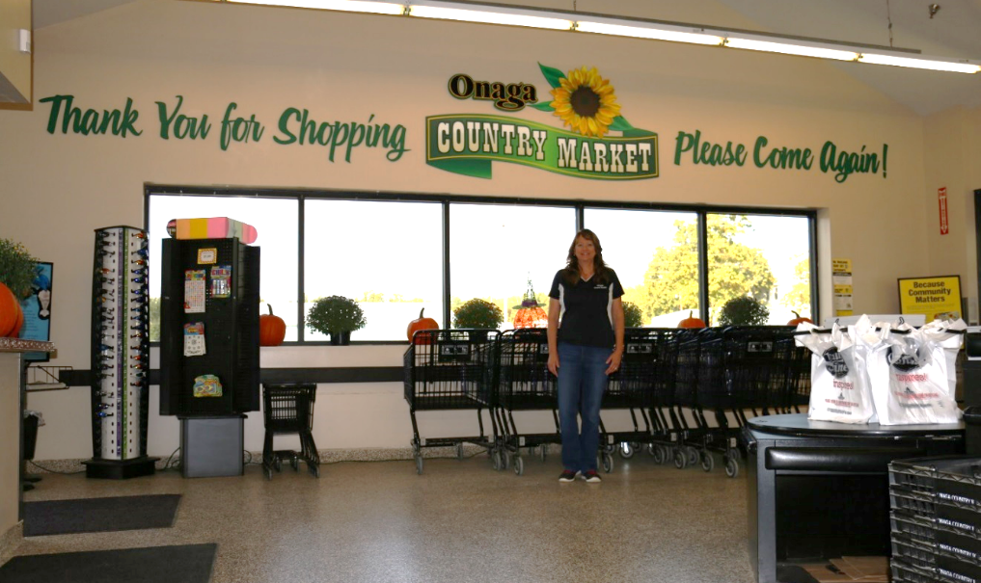
Business & Industry Guaranteed Loans
Onaga Country Market
$500,000 USDA Business & Industry Guaranteed Loan
Purchase equipment needed to construct and operate a new grocery store in Onaga
Multiple funding partners came together to make this project happen including: Network Kansas, City of Onaga, Pottawatomie County

Slide 27
Rural Economic Development Loan & Grant Program (REDLG)

Slide 28
Rural Economic Development Loan & Grant (REDLG) Program
REDLG Program Overview
Electric and Telephone rural utility cooperatives are eligible to apply
- apply for a loan (to pass loan to ultimate recipient (UR)
- or apply for a grant (to establish a RLF)
(RLF) Revolving loan fund to then make loans to UR
The ultimate recipients (UR) then receives a loan. UR’s can be any legal entity, including individuals, corp., public bodies, and federally recognized Indian Tribes

Slide 29
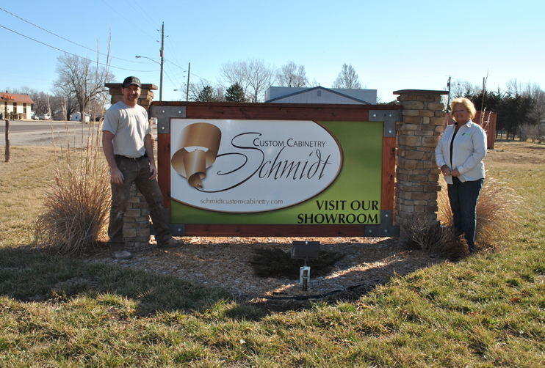
Rural Economic Development Loan & Grant (REDLG) Program
Doug Schmidt Construction
Olpe, Kan
Company received a $180,000 Rural Economic Development Loan through Lyon-Coffey Electric Cooperative (now 4 Rivers Electric) to build a new cabinet making facility and purchase equipment
Notes:
Doug Schmidt began Schmidt Construction, a custom building business, nearly 35 years ago specializing in new homes and remodeling.
The business has grown over the years and in 2004, upon client request, they crafted their first custom-built kitchen cabinets. That was just the beginning. High satisfaction and growing demand has allowed Doug’s son, Tyler, to expand the cabinet-making division into a full-time custom cabinet shop.

Slide 30
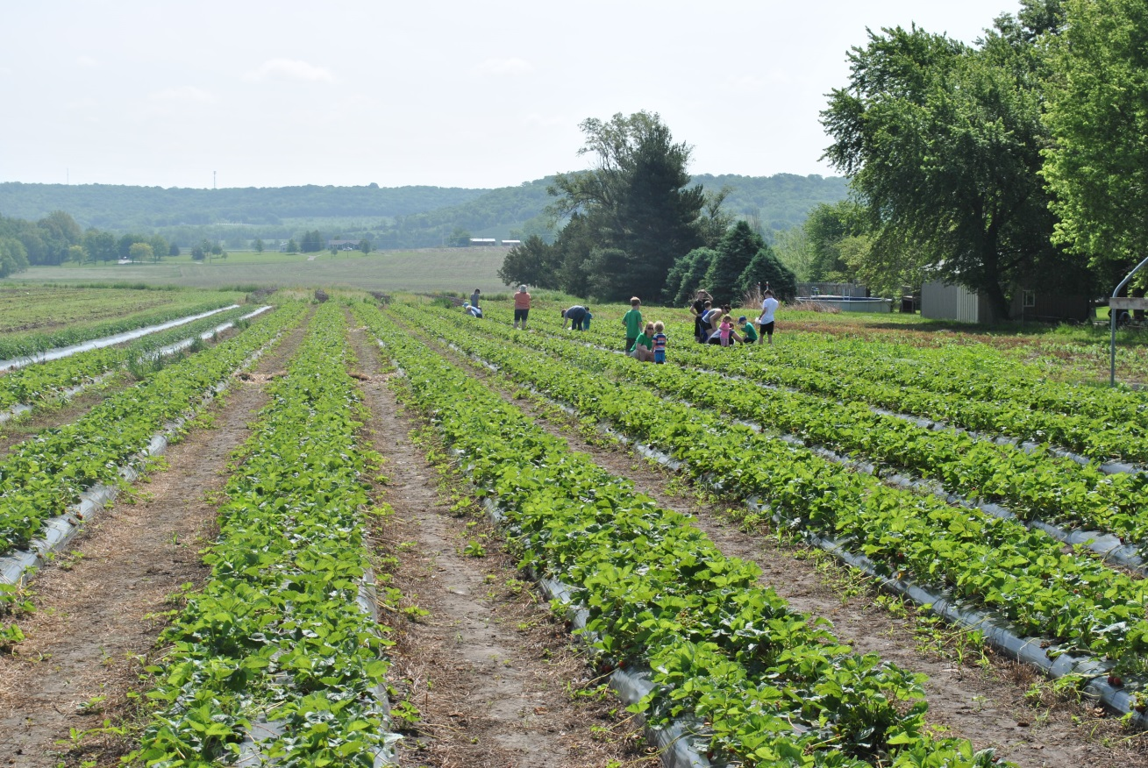
Rural Economic Development Loan (REDLG) Program
Schwinn Produce Farms in Leavenworth, KS utilized a $81,000 Rural Economic Development Loan through Leavenworth-Jefferson Electric Cooperative (now FreeState) construct a building that will act as a retail store – farmers market.

Slide 31
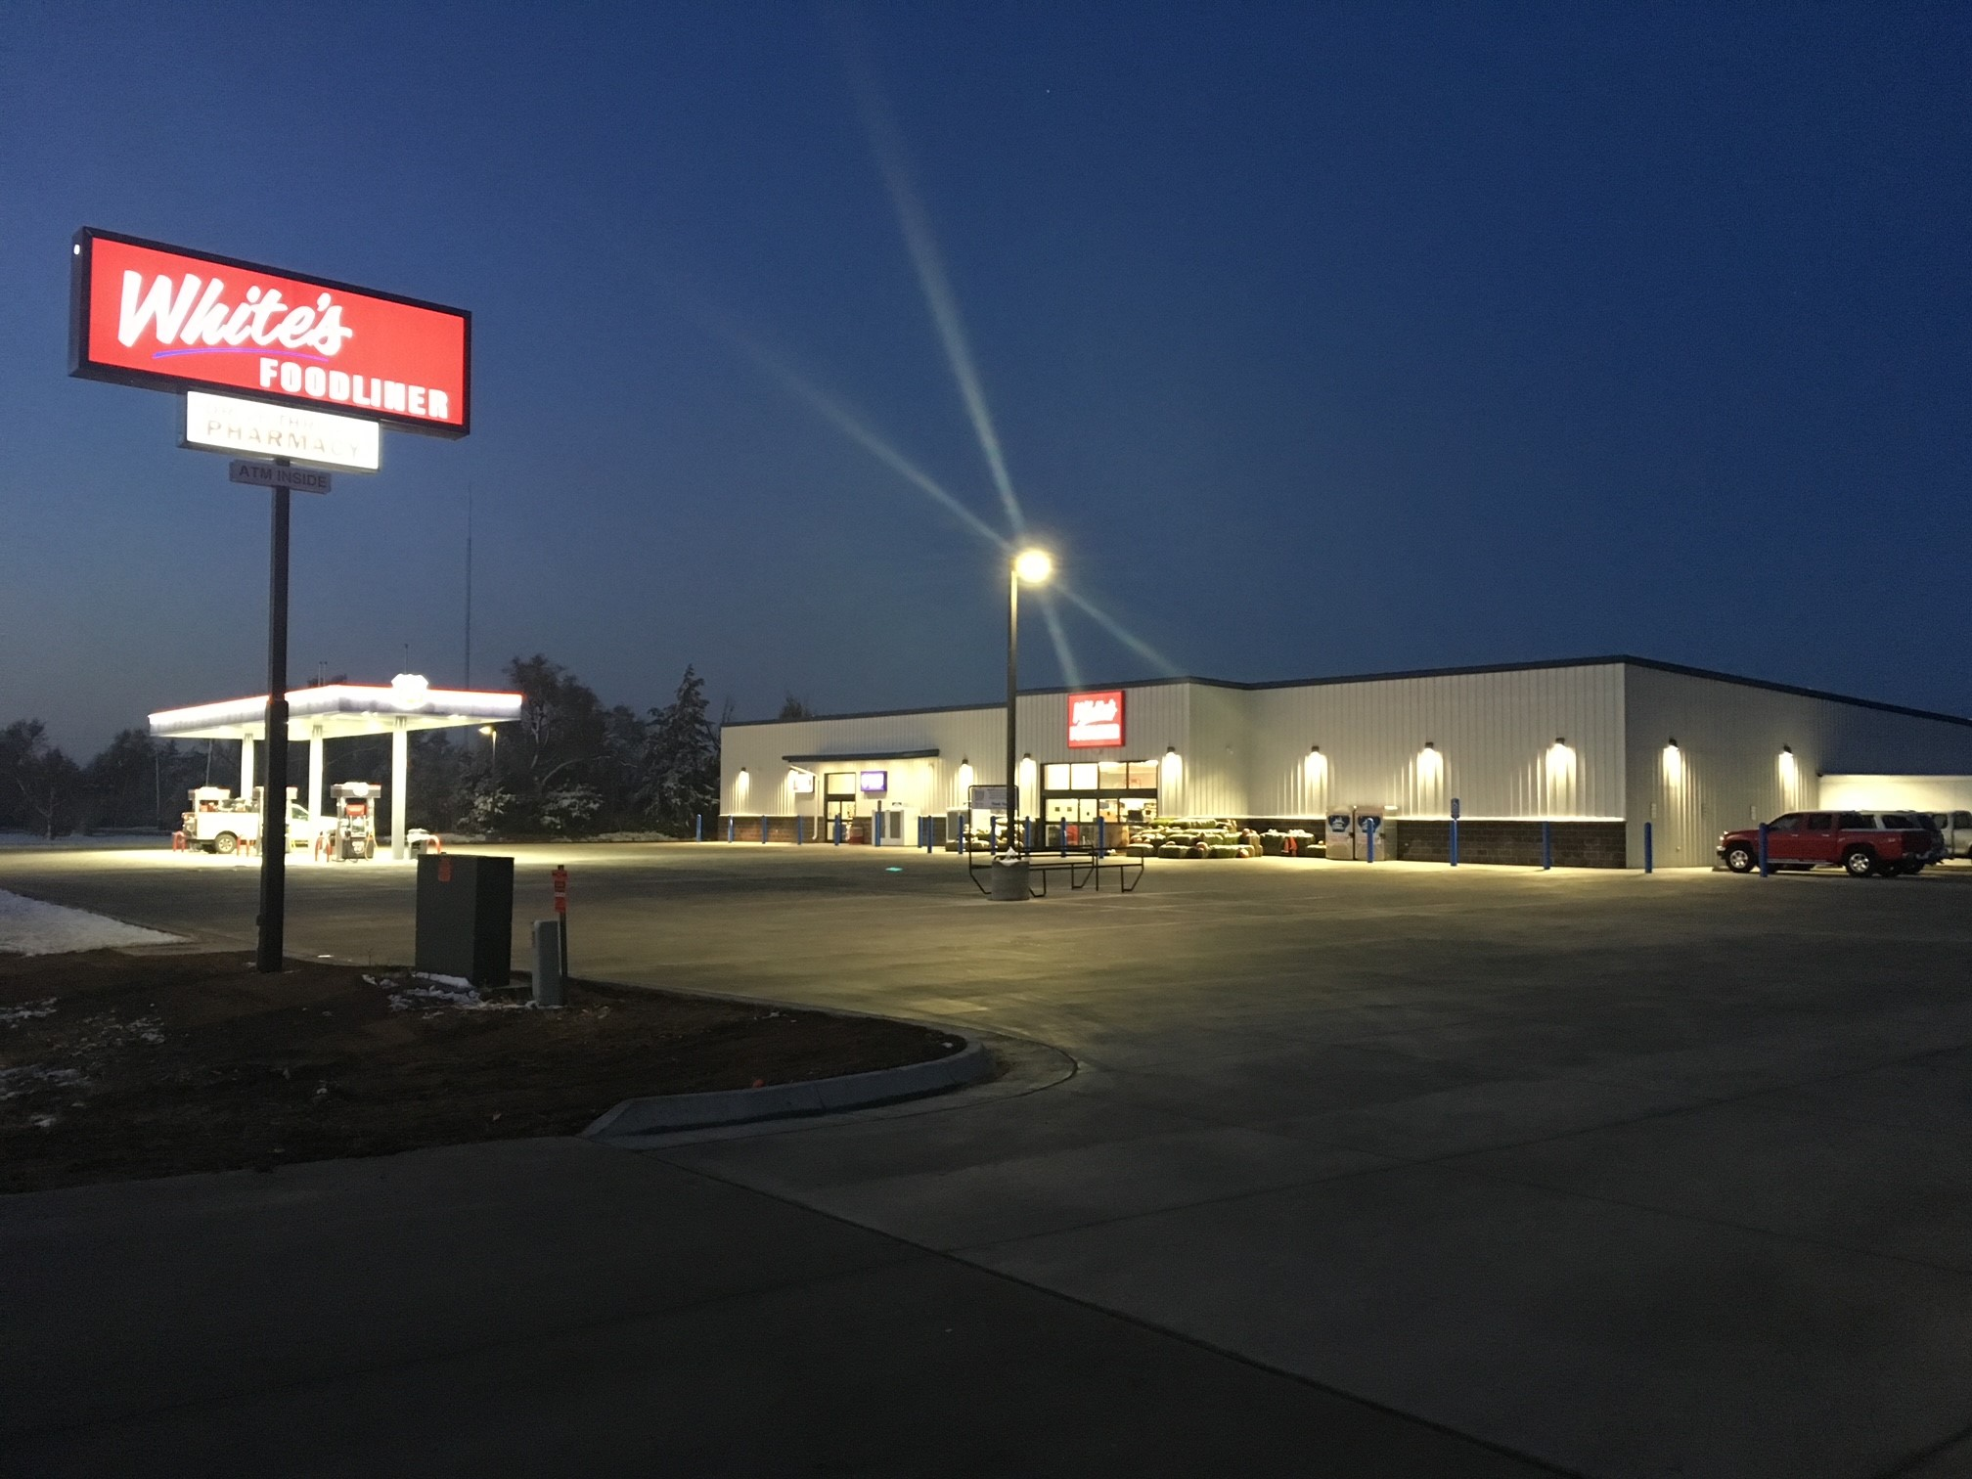
Rural Economic Development Loan and Grant Program
White’s Foodliner (Stafford County Economic Development)
St. John, KS
$1 million RED-L through Golden Belt Telephone
Funds used to assist with construction and equipping of new building for grocery store, pharmacy, fuel station and community space
Multiple funding partners including: SJN Bank of Kansas, Sunflower Foundation, Health Human Services Grant, Individual and Corporate Donations and NetWork Kansas

Slide 32
Rural Energy for America Program (REAP)

Slide 33
Rural Energy for America Program (REAP)
REAP Program Overview
Provides grant funding or guaranteed loan financing to
- rural small businesses or
- agricultural producers
for renewable energy systems or
to make energy efficiency improvements
Grants and Guaranteed Loans
Energy Efficiency improvements and
Renewable Energy systems

Slide 34
Rural Energy for America Program (REAP)
REAP grant applications deadlines: Nov. 1, ‘21 & March 31, 2022
(11-1-21 deadline for $80,000 or less projects only)

Slide 35
Rural Energy for America Program (REAP)
REAP Grants
Up to 25% of Eligible Project Cost

Slide 36
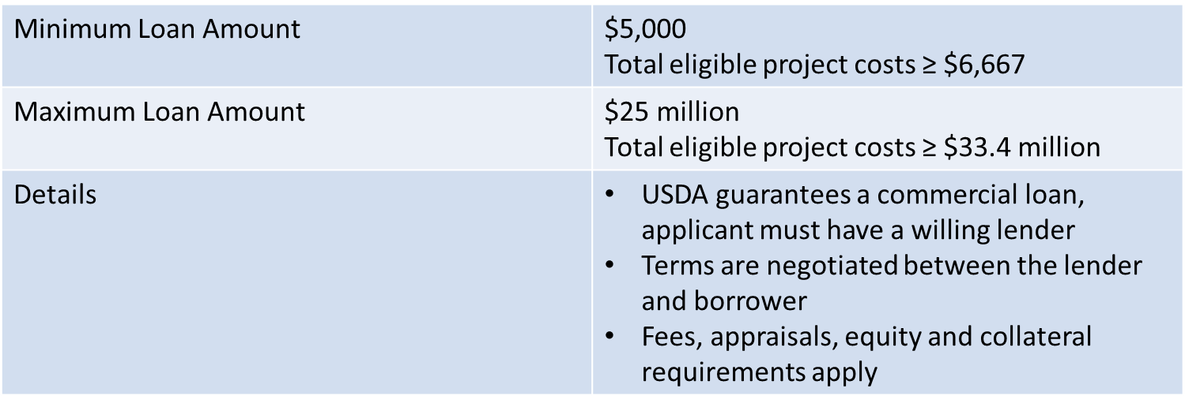
Rural Energy for America Program (REAP)
REAP Guaranteed Loans
Up to 75% of Eligible Project Costs

Slide 37
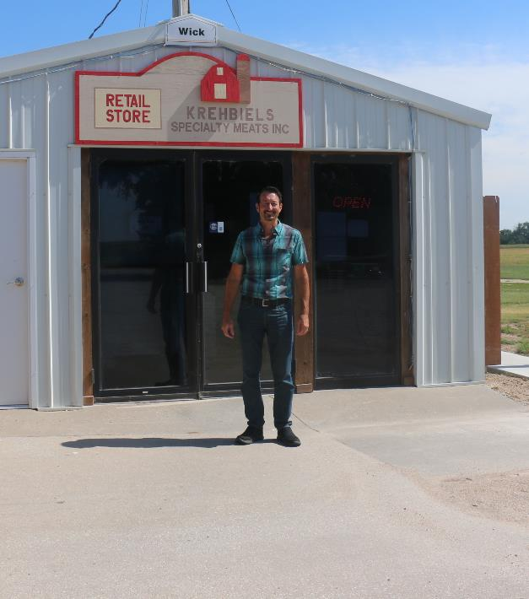
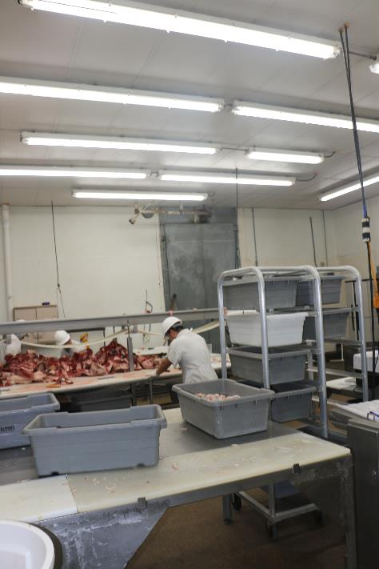
Rural Energy for America Program (REAP)
Krehbiels Specialty Meats, Inc.
McPherson, KS
Replaced existing lighting with energy efficient LED lighting in the retail store and processing plant
Energy savings with approximately 2.53 year simple payback
Total project cost $24,285, received a $6,071 REAP grant

Slide 38
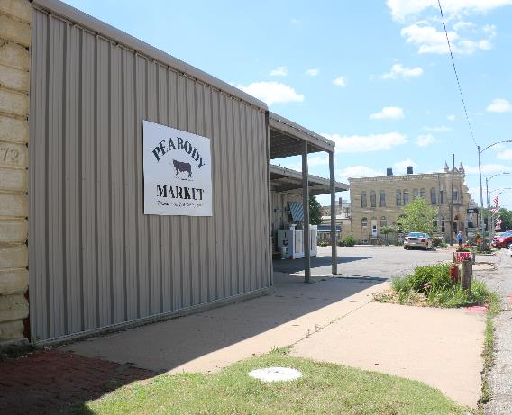
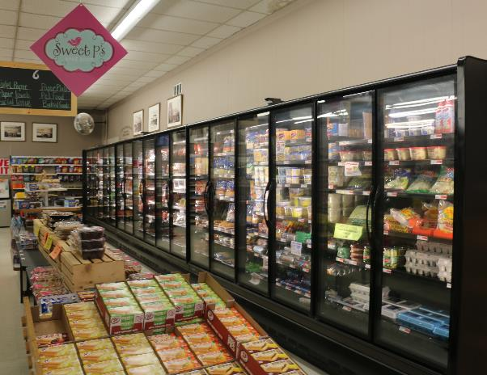
Rural Energy for America Program (REAP)
Peabody Market
Replaced inefficient coolers and refrigerators at the Peabody Market
Significant Energy savings
Total project cost was $36,200, received a $9,050 REAP grant

Slide 39
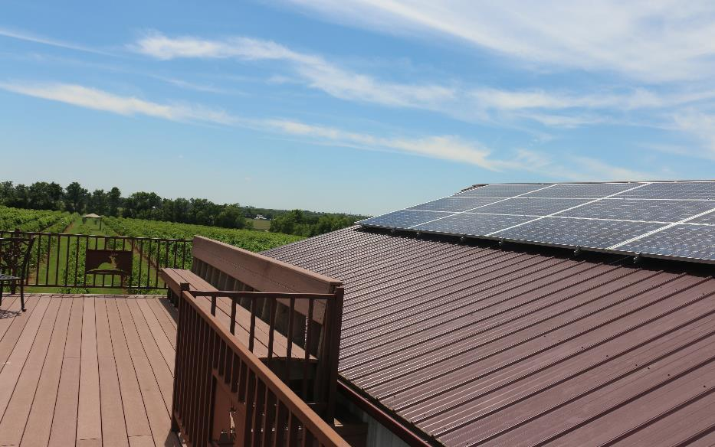
Rural Energy for America Program (REAP)
Sollo Vineyard
Whitewater, Kan.
$20,000 REAP grant to purchase and install a 53 kilowatt solar array
The solar energy created will replace 80% of the business’ energy use per year

Slide 40
USDA Business Programs Staff (in Kansas)
David Kramer Business Programs Director Topeka State Office (785) 271-2736 david.kramer@usda.gov
Nancy Pletcher Business Programs Specialist Topeka State Office (785) 271-2733 nancy.pletcher@usda.gov | Jennifer Yarbrough Business Program Specialist Topeka State Office (785) 271-2727 jennifer.yarbrough@usda.gov | Doug Bruggeman Business Programs Specialist Hays Area Office (785) 628-3081 doug.bruggeman@usda.gov | Travis Snider Business Programs Specialist Newton Area Office (316) 282-3477 travis.snider@usda.gov | William Fritz Business Programs Specialist Iola Area Office (620) 380-3112 William.fritz@usda.gov

